Slide 1
ANSI SQL
Understanding Structured Query Language(SQL

Slide 2
Context Setting: Overview
This session provides knowledge of Database, Relational Database Management System, Normalization, and ANSI SQL.
2

Slide 3
Enabling Objectives
After completing this chapter, in the next 40 minutes you will be able to :
Define with an example at least 1 data model.
List and define at least 1 Database Normalization with an example.
List different Data Types used in a table creation.
3

Slide 4
Key Topics
Using DBMS/RDBMS
Applying Structured Query Language
Notes:
CREATE TABLE command is used to create a table.
ALTER TABLE command is used to modify the table structure
ALTER TABLE command can change the width of the column, data type of the column, add new column, drop existing columns
DROP TABLE command is used to Remove rows and a table structure. Once executed, this statement cannot be rolled back.
RENAME command renames a table, view, sequence, or synonym
TRUNCATE command removes all rows from a table and release the storage space used by the table
The DELETE statement removes only rows.
COMMENT adds a comment to a table or a column.

Slide 5
DBMS

Slide 6
Introduction
Database (DB) is a collection of logically related data.
Database Management System(DBMS) is a set of software or programs that enables/allows to
Store the data
Manipulate the data
Retrieve the data
Data can be retrieved by using Query and Reporting Tools that are part of DBMS.
4
Notes:
A database is a collection of logically related data can be designed for batch processing, real time processing, or online processing
It is used to search data to answer queries.
Database Management System is a set of software or programs that enables storing, modifying, and extracting information from a database.
It also provide users with tools to add, delete, access, modify, and analyze data stored in one location.
A group can access the data by using query and reporting tools that are part of the DBMS, or by using application programs specifically written to access the data.

Slide 7

Data Models
A Data Model is a representation of a real world situation.
Data for the situation is to be collected and stored in a database.
A data model depicts the dataflow and logical interrelationship among different data elements.
6
Notes:
How are the data modeled or structured in DBMS?
To answer this, let us understand the concept of Data Models.

Slide 8
Types of Data Models
Types of Data Models:
Object-based Logical Models
The E-R Model
Record-based Logical Models
The Relational Model
The Network Model
The Hierarchical Model
7

Slide 9
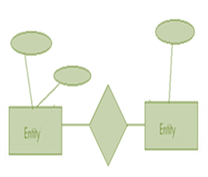
Object-based Logical Models
They describe data at conceptual and view levels.
The Entity-Relationship model (E-R Model)
is based on a perception of the world as a collection of basic objects (entities) and relationships among these objects.
ER- Model
9

Slide 10
Record-based Logical Models
Unlike object-oriented models, this is used to:
Specify overall logical structure of the database, and
Provide a high-level description of the implementation
Each record type defines a fixed number of fields or attributes.
10

Slide 11
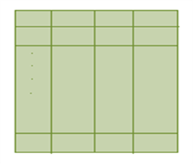
Record-based Logical Models
The Relational Model
Data and relationships are represented by a collection of tables.
Each table has a number of columns with unique names.
Example: customer, account.
Relational Model
11

Slide 12
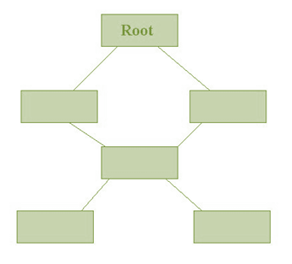
Record-based Logical Models
The Network Model
Data are represented by collection of records.
Relationships among data are represented by links.
Organization is that of an arbitrary graph.
Network Model
12

Slide 13
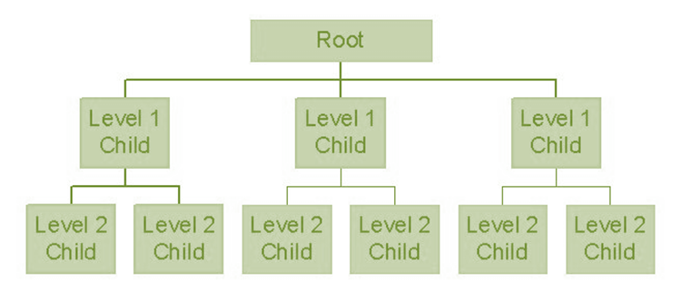
Record-based Logical Models
The Hierarchical Model
Is similar to the Network model.
Organization of the records is like a collection of trees, rather than arbitrary graphs.
Hierarchical Model

Slide 14
Definition of RDMS
Relational Database Management System (RDBMS) is a Database Management System (DBMS) that is based on the Relational model.
Attribute
(StudentID)
Entity
(Student)
Attribute
(StudentName)
Relationship
(Enrolled)
Entity
(Course)
11

Slide 15
Database Normalization
How to reduce data redundancy and inconsistency in database tables?
Normalization Process
12

Slide 16
Database Normalization
Is the process of organizing the fields and tables of a relational database
minimizes redundancy and dependency.
involves dividing large tables into smaller (and less redundant) tables and defining relationships between them.
12

Slide 17
Normal Forms
First Normal Form (1NF) of Normalization is invented by Edgar F. Codd in 1970.
Second Normal Form (2NF) and Third Normal Form (3NF) in 1971, By Codd and Raymond F.
Boyce defined the Boyce-Codd Normal Form (BCNF) in 1974.
13

Slide 18
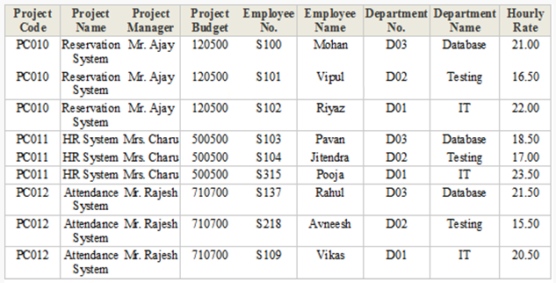
Normal Forms(NF)
Consider the following de-normalized database table.
We will normalize the data of the following table using normal forms.
14

Slide 19
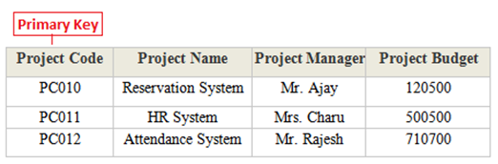
First Normal Form(1NF)
A database table is said to be in 1NF if it contains no repeated fields or columns.
The process of converting the Un-NF table into 1NF is as follows:
Separate the repeated fields into new database tables along with the key from de-normalized database table.
The primary key of new database tables might be a composite key.
15

Slide 20
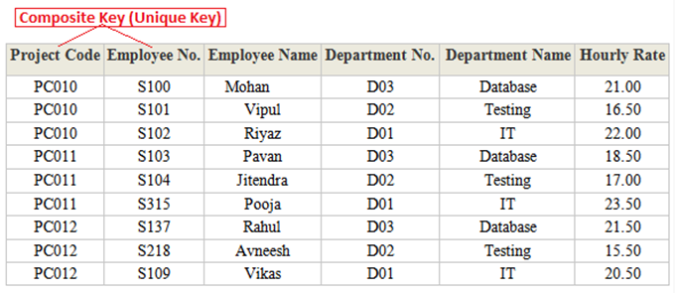
First Normal Form
16

Slide 21
Second Normal Form(2NF)
A database table is said to be in 2NF if it is in 1NF and contains only those fields or columns that are functionally dependent.
The process of converting the database table into 2NF is as follows:
Remove the partial dependencies of any non-key field.
Example:
If field B depends on field A and vice versa.
For a given value of B, we have only one possible value of A and vice versa.
Then put the field B into new database table.
In the new table, B will be the primary key and also marked as foreign key in parent table.
17
Notes:
Functionally dependent - The value of the field is determined by the value of another field(s))
on the primary key.
In 2NF, we remove the partial dependencies of any non-key field.

Slide 22
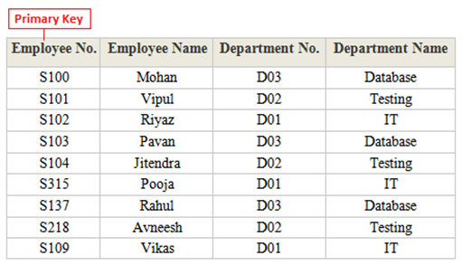
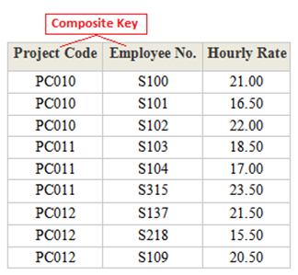
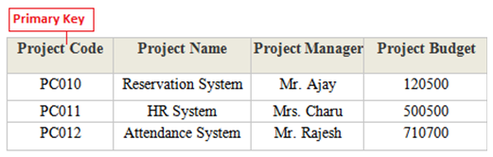
Second Normal Form
Example: 2NF of the 1NF tables
18
Notes:
A database table is said to be in 2NF if it is in 1NF and contains only those fields or columns that are functionally dependent.
The process of converting the database table into 2NF is as follows:
Remove the partial dependencies of any non-key field.
Example:
If field B depends on field A and vice versa.
For a given value of B, we have only one possible value of A and vice versa.
Then put the field B into new database table.
In the new table, B will be the primary key and also marked as foreign key in parent table.

Slide 23
Third Normal Form
A database table is said to be in 3NF if it is in 2NF and all non key fields are dependent on a primary key.
The process of converting a table into 3NF is as follows:
Remove the transitive dependences
Make separate table for transitive dependent field.
19
Notes:
Transitive Dependency – is a type of functional dependency where a field is functionally dependent on the field that is not the primary key. Hence its value is determined, indirectly by the primary key

Slide 24
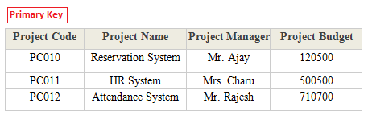
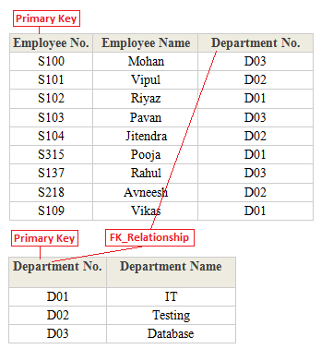
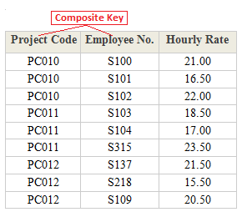
Third Normal Form
20

Slide 25
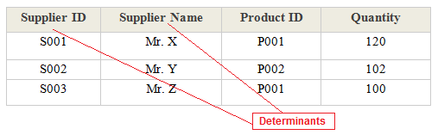
Boyce Code Normal Form(BCNF)
A database table is said to be in BCNF if it is in 3NF and contains each and every determinant as a candidate key.
The process of converting a table into BCNF is as follows:
Remove the non-trivial functional dependency
Make separate table for the determinants
Let us consider the special situation given below to understand BCNF:
21

Slide 26
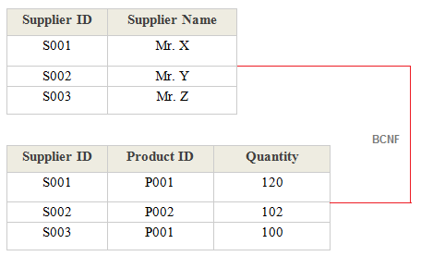
Boyce Code Normal Form(BCNF)
Let us consider the special situation given below to understand BCNF:
After applying BCNF:
21

Slide 27
ANSI -SQL

Slide 28
SQL
Question:
How the data is accessed from RDBMS?
Answer:
Through Structured Query Language(SQL)

Slide 29
SQL
Structured Query Language (SQL): Special-purpose programming language designed for managing data in RDBMS.
It is a 4th Generation Language or 4GL.
First Generation Language or 1GL:
These are machine languages.
Second Generation Language or 2GL:
These are assembly languages.
Third Generation Language or 3GL:
These are high-level programming languages, such as C, C++, and Java.
Fourth Generation Language or 4GL:
These are programming languages closer to human languages than typical high-level programming languages.
Fifth Generation Language or 5GL:
These languages are used for artificial intelligence and neural networks.
24

Slide 30
SQL
SQL statements are used to perform tasks such as
Execute queries against a database
Retrieve data from a database
Insert/ Update/ Delete records in a database
Create new databases and Tables
Some common RDBMS that use SQL are:
Oracle, Sybase, Microsoft SQL Server, Access, Ingres.
24

Slide 31
ANSI SQL
American National Standards Institute (ANSI):
SQL was adopted as a standard by the American National Standards Institute (ANSI) in 1986 as SQL-86 and the International Organization for Standardization (ISO) in 1987.
25

Slide 32
Keywords Used
Database Management System
RDBMS
Relational Database Management System
1NF
First Normal Form
2NF
3NF
BCNF
SQL
Second Normal Form
Third Normal Form
Boyce Code Normal Form
Structured Query Language
ANSI
American National Standards Institute
DBMS
28

Slide 33
Data Types
Specifies storage format
Specifies constraints, and a valid range of values.
Must to specify a datatype for each columns
CREATE TABLE Employee (
employee_code number(4),
employee_name varchar2(20),
hire_date date,
);
Notes:
Datatypes
Each column value and constant in a SQL statement has a datatype, which is associated with a specific storage format, constraints, and a valid range of values.
When you create a table, you must specify a datatype for each of its columns.

Slide 34
Data Types
Inbuilt data type: Define by oracle
User Defined type : Created by user
Oracle data types
Inbuilt Data Types
User Defined Types
Character
Numeric
Date
BLOB.CLOB

Slide 35
Data Types
Data Type | Description
varchar2(size) | Variable-length character
char (size) | Fixed-length character data
Number( p, s) | Variable-length numeric data
Date | Date and time values
Long | Variable-length character data up to 2GB

Slide 36
Data Types
Data Type | Description
Clob | Character data up to 4GB
Raw and long raw | Raw binary data
Blob | Binary data up to 4 GB( unstructured data: text ,image, video)
BFile | Binary data stored in an external file ; up to 4GB
Rowid | A 64 base unique address of a row in a table

Slide 37
Test Your Understanding
Explain RDBMS.
What is the need of Normalization?
Why should you know ANSI SQL?
29

Slide 38
RECAP
In this chapter we have learnt to:
Define Database (DB), Database Management System (DBMS) and Relational Database Management System (RDBMS)
Identify different data models
List the different Database Normalization.
List different Data Types used in a table creation.
38

Slide 39
You have successfully completed -
Session on Understanding SQL

